Slide 1

ARGENTO
Online Success
Joseph Cushley
Digital Marketing Manager

Slide 2

Background
Current Position
Online Platform
Shipping to 92 Countries
52
500
92
Stores
Employees

Slide 3
Background
Interview with Pete Boyle | Owner and Founder.
Evolution from street trader to owning the UK’s fastest growing jewellery retailer.
PLAY VIDEO

Slide 4
Online
Our First Month Online in 2009 we made £200
“I could have made more in a days street trading”
Argento CEO

Slide 5
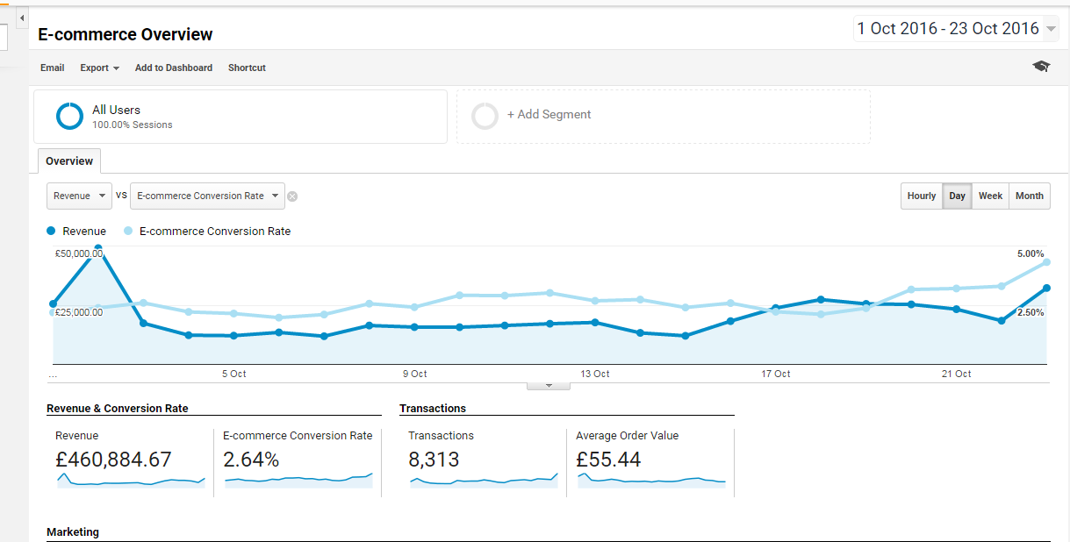
Online
Today
October 1st- 23rd
Argento CEO

Slide 6
Online
2016
18% of our sales are exports
Across 92 countries
Exports are expected to account for over 30% of our sales next year
September 2016
£64,500 sold to Hong Kong
£24,000 sold to Japan
£14,000 to China
Ecommerce is now a big priority for Argento

Slide 7
Online
How Did We get Here?
1. Right Technology
2. Right Product
3. Generating profitable Traffic
4. Social Media
5. Going Global
Argento CEO

Slide 8
Online
1. The Right Technology
The right Web Platform
Argento teamed up with IRP in 2009 after hearing of the success with Chain Reaction.
The business model suited our needs.
No set up costs

Slide 9
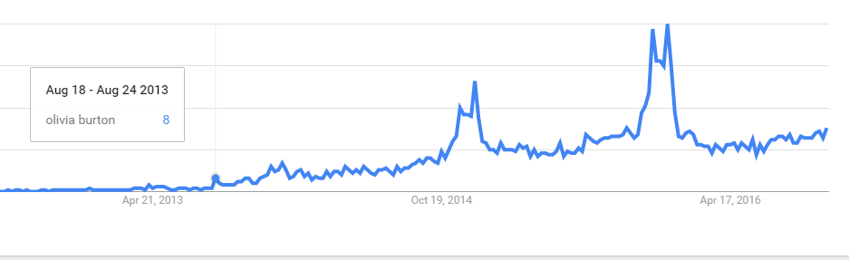
Online
Market Trends
Where previously word of mouth and recommendation informed purchasing decisions now Analytics are used to predict trends and inform purchasing decisions.
Argento decided to stock Watch Brand Olivia Burton after analysing UK Search Volume for the brand.

Slide 10



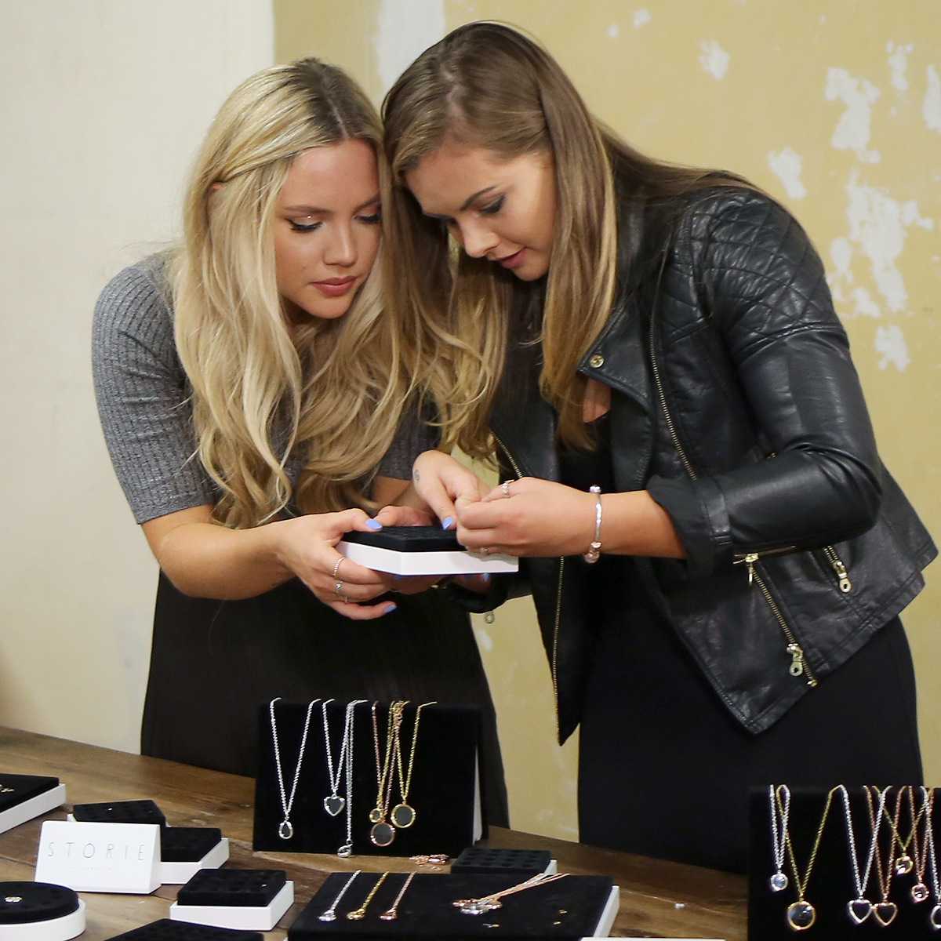
Online
Exclusive Product

Slide 11
Online
3. Generating Website Traffic
Having a website that no one finds is of little value.
Generating web traffic profitably has been keys
Google, Bing, affiliates, social media.

Slide 12
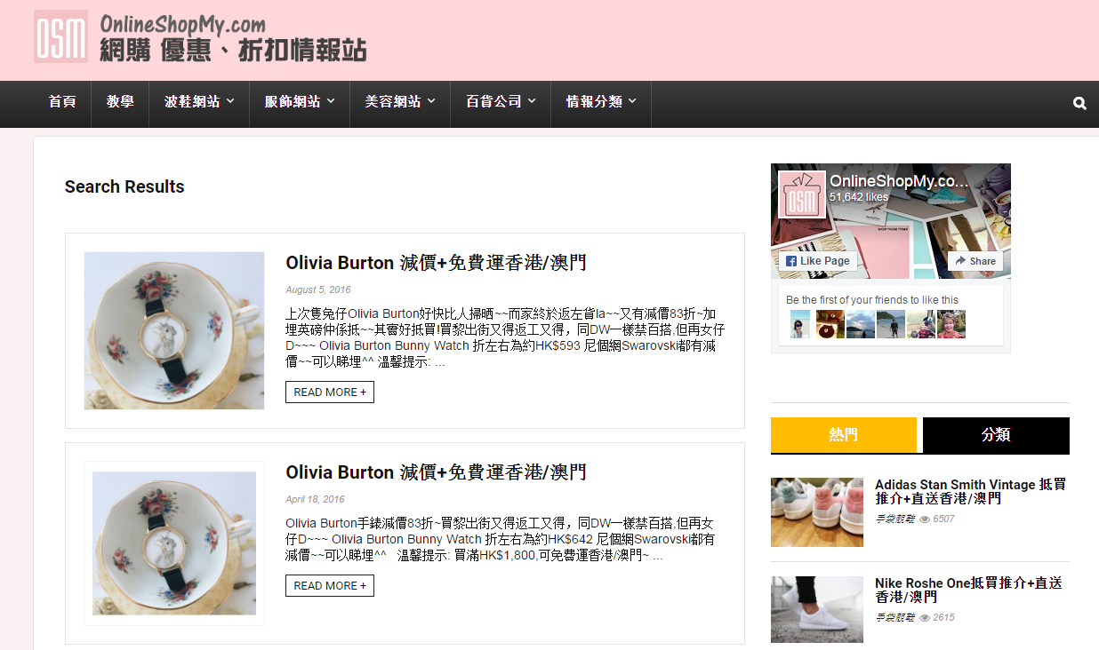
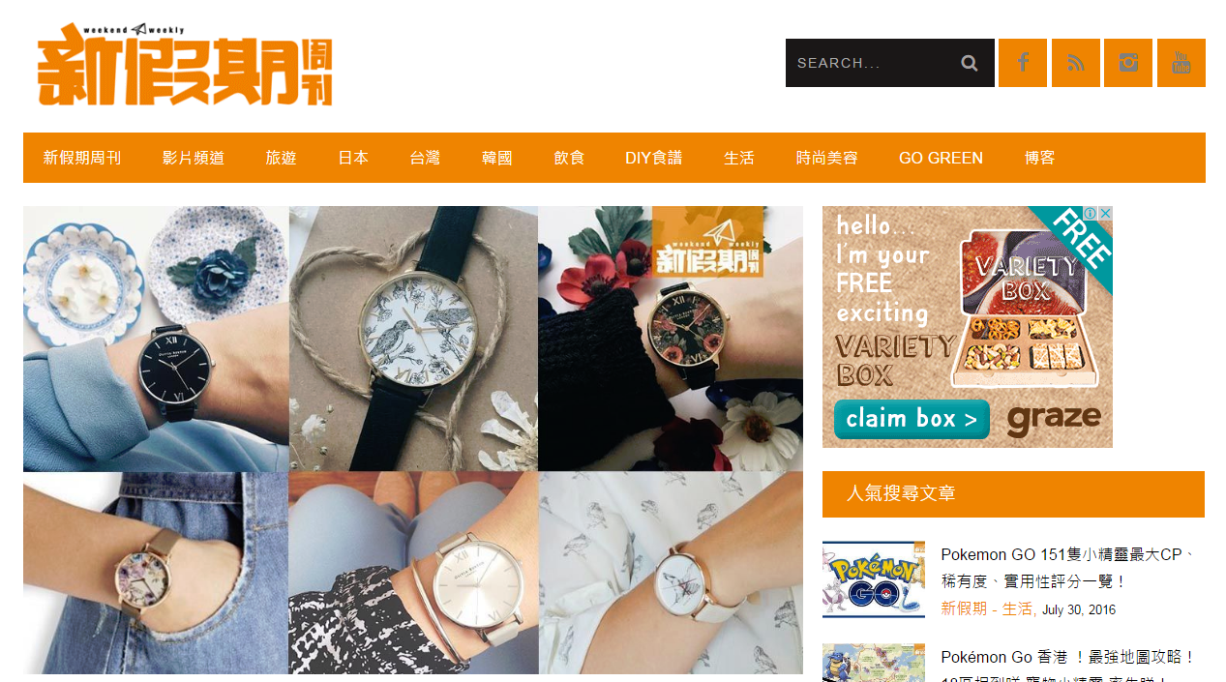
Online
Affiliates
A network of in market affiliates
has become important for growth.

Slide 13
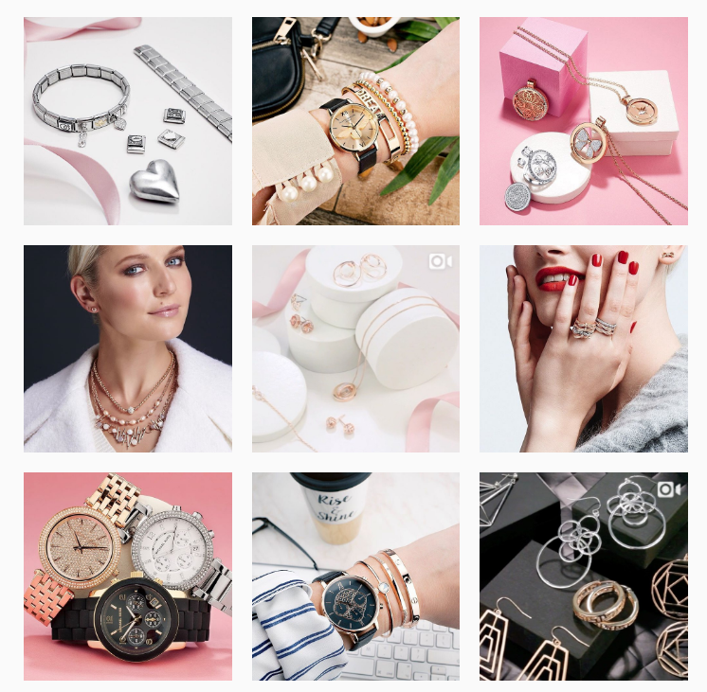
Online
Social Media
Peer to Peer recommendation
Commercial posts/ following brands have become the norm
Detailed targeting available and the power of Facebook advertising

Slide 14



Online
5. Going Global
In 2014 approximately 5% of sales were to export markets.
Focused initially on :
1 English Speaking Markets
2 Europe

Slide 15




Online
Going Global
In 2016 our largest Export Markets are:
Hong Kong
Japan
China
Macau

Slide 16





Online
The Future
We expect our exports to account for over 30% of online revenue in 2017
Importance of Mobile
Over 60 percent of transactions now take place on a mobile device.

Slide 18

EXPORT TECHNOLOGIES
A winning partnership
Jo-Anne Nicholl
Account & Project Manager, Export Technologies

Slide 19
Introduction to Export Technologies
Based in Catalyst Inc (NISP)
Official Solution Provider for the IRP
Successfully deployed the IRP for a wide variety of businesses in the UK and Ireland for nearly 15 years.
Specialising in taking retailers, manufacturers and distributors from the SME market to the mid-market and beyond by offering an enterprise-level platform which would be out of reach of most
Deloitte Fast 50 winner for 5 consecutive years

Slide 20
Working with Argento
We provide Argento with a full ecommerce service which includes;
  Account Management
  Ecommerce Consultancy
  Digital Maintenance
  Training
  Full Service Platform Support
  Monthly Reporting & Analytics

Slide 21
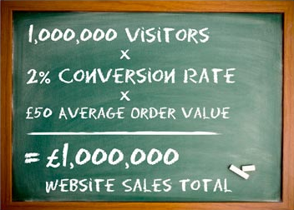
Important Ecommerce Elements
The fundamentals of ecommerce are;
Traffic – where do you get your traffic from? (Pre)
Conversion – how do you convert visitors? (During)
Retention – how do you ensure they come back? (Post)
The Ecommerce Equation
Visitors x Conversion Rate x Average Order Value =
Total Website Sales
Argento’s team work closely with us to make the most of all elements of this equation and fully understands the fundamentals

Slide 22
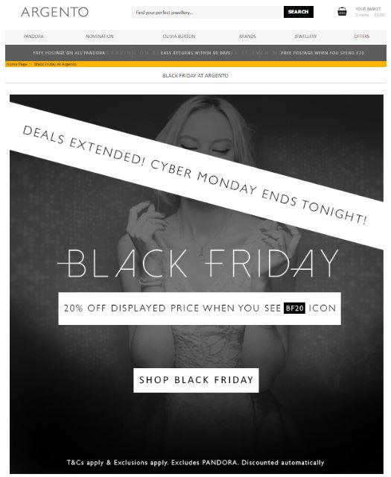
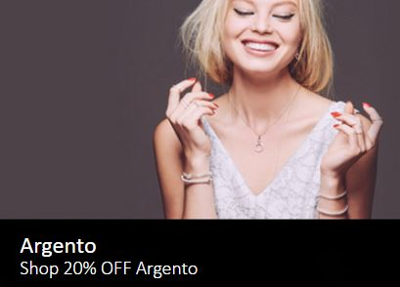
Working with Argento – Black Friday Campaign
Huge Sale Friday after US Thanksgiving, followed by Cyber Monday
Key Elements of Online Sales Collateral
Updated Product Data (-20%)
PPC Campaigns to drive traffic
Content Pages pushing products
Images on the website
Remarketing imagery
Emails
Social Media Advertising
Multi channeled approach
Offline pushing sales online

Slide 23
Working with Argento
73%

Slide 24
Key to Success with Argento
Use of great technology & understanding how to use it
In depth understanding of the ecommerce industry
Multi Channeled Approach > offline complementing online
Revenue Shared Model in our interest for the client to perform
Transparency with results via reporting and results

Slide 25
Thank you

