Slide 1
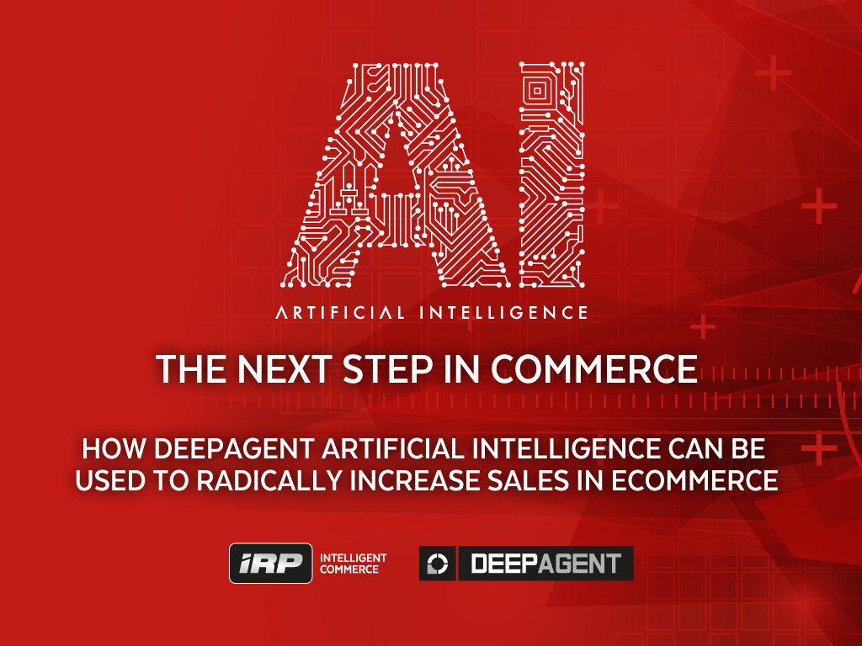

Slide 2
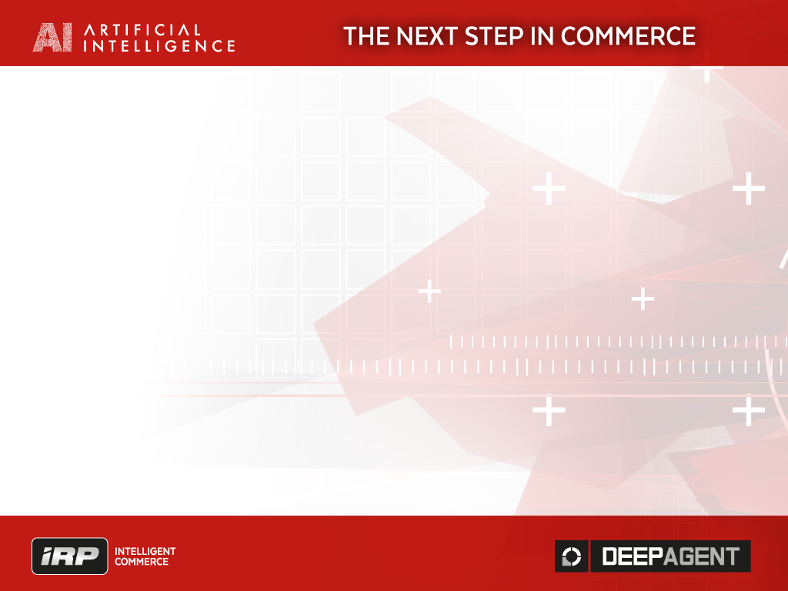
About IRP Commerce
Product division of
Software engineering company that built the IRP Commerce platform
Research division is based in Northern Ireland Science Park
Committed to RnD
Deloitte Fast 50 – 2010, 2011, 2012, 2013, 2014

Slide 3

IRP platform's performance in Commerce
The IRP platform has transacted over £1 Billion for NI companies
IRP technology is totally focused on sales
The IRP platform was built originally for CRC in 2000
and was running their site for almost 14 years
Developed much of the online strategy for CRC
CRC started at 0 online sales –
final 12 months’ sales on IRP was £180M
69% compound growth achieved over 13 years

Slide 4







Let’s look at some markets that
Software has already helped disrupt (by IBM)
World’s largest taxi company owns no taxi
Largest accommodation provider owns no real estate
Largest phone companies own no telco infrastructure
World’s most valuable retailer has no inventory
Most popular media owner creates no content
Fastest growing banks have no actual money

Slide 5



Let’s look at some markets that
Software has already helped disrupt
World’s largest movie house owns no cinemas
Largest software vendors don’t write the apps
CRC the largest bike market

Slide 6
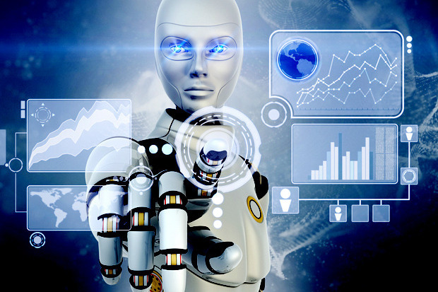
Next wave of disruption in software will be based on
Machine Learning & Artificial Intelligence
Machines have entered into a new era where they
can "learn for themselves" something like people
Think about how you learn - like computers you
learn from information you receive and then process
Machines can now do this as well
Things we thought required Human Intelligence
…increasingly require just intelligence

Slide 7
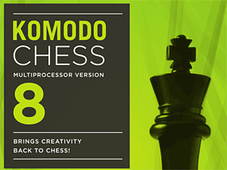
The AI era of Machines outperforming in new areas
Best chess player... is Komodo 8 - 64-bit 4CPU
Best stock traders - highly secretive AI
adaptions of IBM's MGD, Hewlett-Packard's ZIP
Best Weather Forecaster - IBM Met
Office Super Computer
Future Best Online Marketeers
….Best ecommerce Managers etc…

Slide 8

Basics of How AI Works - Information is key
AI and Machine Learning are simple in principle
People have to construct the AI models
Computers and people both learn from Information
Computers are very good at understanding patterns
With "perfect information" you can begin to predict future outcomes better
Knowing what is going to happen or even a likelihood
has huge value - in its basic form a "Winning Bet”
Not knowing an outcome in advance is simply a
lack of information…..

Slide 9
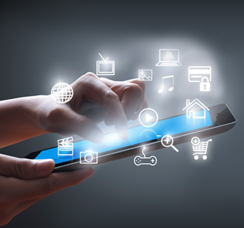
DeepAgent AI in practice in ecommerce
Digital commerce contains complex data
patterns - hidden in this data is information that
contains a lot of value
We use DeepAgent AI to find these patterns
to increase sales and profits on IRP ecommerce sites
Each customer forms an individual fingerprint by
their actions on a site
The AI can monetise the information by
predicting outcomes and changing the individual session
AI can understand the needle… and the haystack…

Slide 10

How AI works in the IRP Platform
DeepAgent AI is built to maximise profits in ecommerce
DeepAgent can predict individual customer outcomes –
Logistic Regression - buyer or not, value & probability
of purchase
DeepAgent aggregates micro outcomes in the cloud for
comparison in markets and to advise on macro strategy
DeepAgent can work on a customer’s behalf as a sales
agent to manipulate individual sessions
DeepAgent does this by understanding information
DeepAgent knows how to Visualise, Predict and Intervene

Slide 11
DeepAgent real-time example of
Purchase Prediction & Intervention

Slide 12
Final Slide
SIs - Implementation Partners
SPs - Service Providers to the IRP World
IRP Customers - companies that want to break
new ground in ecommerce

Slide 13

Email - Sales@IRPCommerce.com

Slide 14

Q&A
THANK YOU

