Slide 1
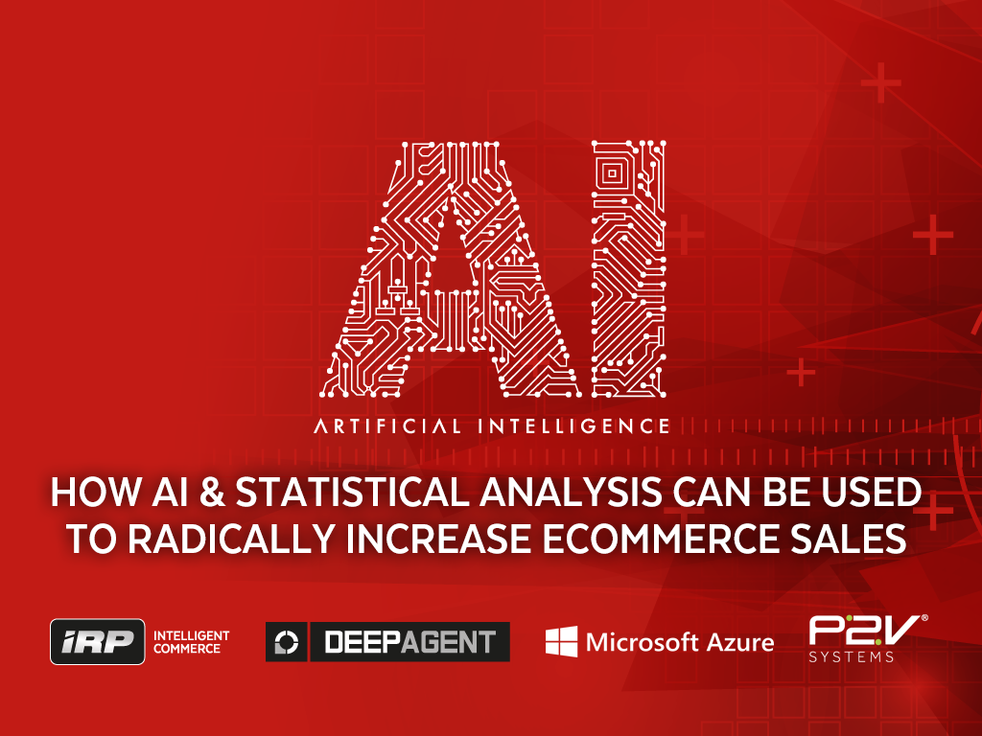

Slide 2
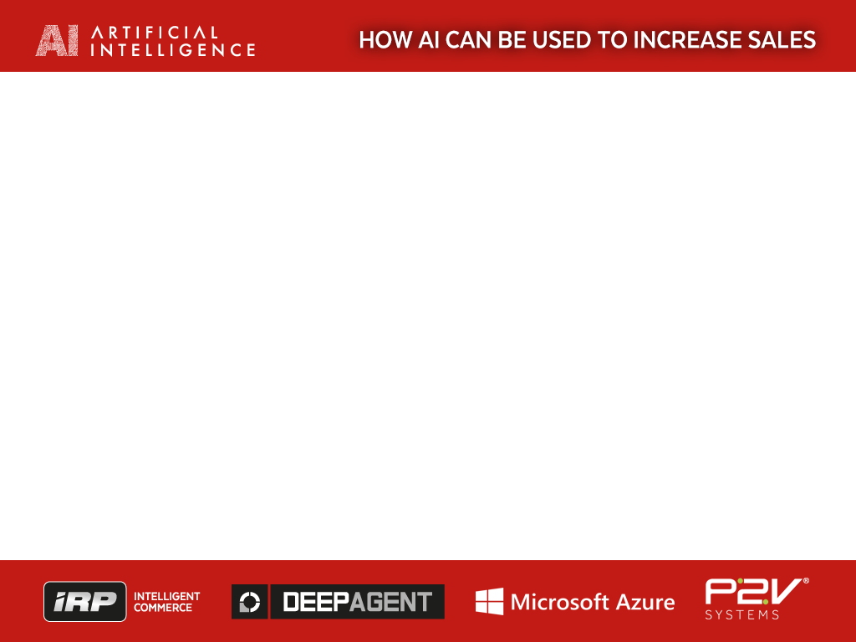
IRP is Hosted Securely by P2V on Azure
We have partnered with P2V to host the IRP platform on Azure – who provide the security and computing power needed for hosting a modern ecommerce System like the IRP

Slide 3
About IRP COMMERCE
Daniel Loughlin – CEO IRP Commerce. Based in Northern Ireland Science Park we provide the IRP Ecommerce Platform to clients in UK, Ireland & USA
The IRP Platform has securely transacted Over £1 Billion for NI Companies
Focused on RnD in Ecommerce technology - AI now plays a big part in our RnD with the DeepAgent AI module
Businesses are copying Finance 20 years ago – automation and algorithms allow them to outperform their competition and make markets efficient
For businesses - the interest in AI should be to MAKE MORE PROFITS, gain competitive advantage and to outperform their market
> £1,000,000,000 GBP to > 170 Countries

Slide 4
The Goal of Data and AI in Ecommerce
“If you don't know where you are going, every road will get you nowhere.” Henry Kissinger
We have found this to be true in Ecommerce, AI and analytics – if they are not directional towards Sales – you will get nowhere

Slide 5
WHAT DOES THE PRESENTATION COVER
I plan to cover 3 areas in this presentation
1) Introduction to Ecommerce, how to measure Ecommerce Success, BIG DATA, Benchmarking
2) CONVERSION Strategy with DeepAgent AI technology – using AI for One to One selling.
3) DeepAgent AI Demo in the IRP Platform

Slide 6
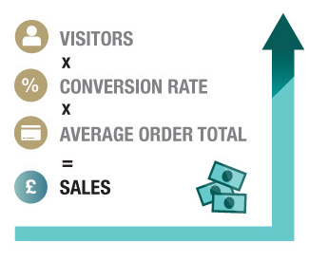
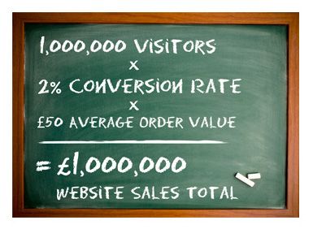
Ecommerce is About Sales & Measurement is key
Ecommerce is based on fundamental maths &
a Quantitative approach is needed

Slide 7
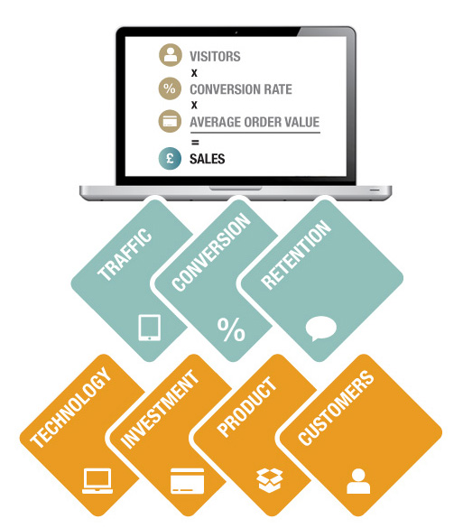
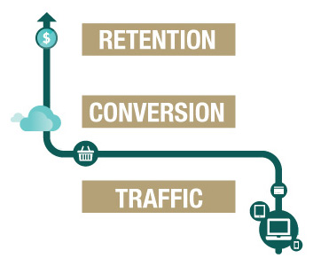
How to measure ecommerce success
TRAFFIC – CONVERSION - RETENTION
AI plays an increasing role in ALL of these in Ecommerce

Slide 8
Data Comparison and Benchmarking is key
Big DATA – a Quantitative Approach to Ecommerce
Big Data the guesswork out of the performance of a traffic
Big Data Benchmarking tells us if something is GOOD or BAD
Assess your current Service Provider (eg PPC Agency, Social Media Marketer) objectively.
Key Metrics: Sales, Channel (eg Google PPC), Agency, Cost of Sales
Deskill ecommerce process and assemble the correct team
GOOD DATA is also the FUEL on which Machine Learning Runs

Slide 9
Data Comparison and Benchmarking is key
Constructing a house
Constructing Ecommerce Team

Slide 10




Conversion Strategy with DeepAgent AI
AI TECHNOLOGY IS KEY!
Multichannel International
Technology With Intelligence
IRP PLATFORM
Multichannel
International
Technology
Website
Technology
Multichannel
Technology

Slide 11
Conversion Strategy with DeepAgent AI technology
Once you have a solid Big Data quantitative E-commerce strategy in place you need to maximise your sales
IRP does this through a DeepAgent AI module
AI resembles people because it can LEARN and notice patterns
We use AI to operate a 1 to 1 selling process as it learns customer behavior
Radically Increases CONVERSION RATES & REVENUES
TECHNOLOGIES USED – ACCORD AI FRAMEWORK USING LOGISTIC REGRESSION on AZURE
DeepAgent AI allows DATA to become INFORMATION to become PREDICTIONS to become ACTIONS to become SALES

Slide 12
Conversion Strategy with DeepAgent AI technology
How does DeepAgent AI technology work in website CONVERSION
Every visitor has a different PROBABILITY of buying
DeepAgent AI can LEARN the PROBABLITY of buying using machine learning and the CHANGES in PROBABILITY based on the customers behavior
The AI can then intervene and MANIPLUATE the clients individual session to maximise the PROBABILITY of a successful outcome (SALE)
This 1 to 1 micro level strategy will increase SALES dramatically by increasing CONVERSION RATES sometimes > 100%….

Slide 13
Conversion Strategy with DeepAgent AI technology
DEEPAGENT DEMO

Slide 14
Conclusion
Starts with DATA, becomes INFORMATION, through AI PREDICTION becomes ACTIONS – then finally becomes REVENUES
We feed DATA to a Machine Learning Framework
DeepAgent AI can understand the Needle and the Haystack
Downsides? Takes a lot of compute power – Azure has been useful to us
AI related Technologies like DeepAgent can give a huge advantage – it can CONVERT 2 x as many CUSTOMERS – leading to 100%+ increase in SALES
Ultimately – you can be 100% sure AI and ML will play a huge part in SALES and PROFITABILITY of companies in 2018 onwards

Slide 15
Thanks for listening
Daniel Loughlin
Linked IN
www.irpcommerce.com
daniel@irpcommerce.com

