Slide 1

THE OWNERS ROLE IN
ECOMMERCE SUCCESS &
how the IRP World can help

Slide 2

WHY HAVE THIS PRESENTATION TO OWNERS ?
The Owner is a major factor in Ecommerce Success
The Owner is the key decision maker in the business
Owner buy in to Ecommerce leads to great results for everyone
Owners are facing new influences and new decisions in fast moving ecommerce landscape
Owners are Domain Experts in their field but face a different challenge in Ecommerce
The presentation is also demonstrate the information that the IRP World offers to help you
WHY BUSINESS OWNERS ARE KEY

Slide 3
A QUICK INTRODUCTION TO IRP COMMERCE
IRP IS THE PRODUCT DIVISION OF EXPORT TECHNOLOGIES
Founded 2005, 30 employees
Strong Research & Development Team
Technology employed in UK, IRELAND, USA
Sales Growth >40% YOY ON Existing clients
We work to grow your revenue - we do this by supplying you with: Best of Breed Technology, Performance Analytics, Vital Information and Resources across the IRP and IRP World
Sales impact of the IRP to date generated > £1 Billion 170 Countries
BACKGROUND ON IRP COMMERCE

Slide 4
WHAT WILL THE IRP WORLD ECOSYSTEM LOOK LIKE
IRP WORLD CONCEPT
The IRP Ecosystem links together resources
We all need to be connected in to leverage the skills and information that we have collectively available
THE IRP & IRP WORLD ECOSYSTEM COVERS ECOMMERCE REQUIREMENTS
HOW THE IRP WORLD ECOSYSTEM LOOKS

Slide 5
THE IRP HAS INVESTED HEAVILY IN SOFTWARE
The IRP is proven, highly stable, scalable, compliant, secure Tier 1 technology
£8 M technology investment to date in the IRP & IRP World & 1M committed to RnD in 2017
Mid and top Tier platforms comparable to IRP are : SAP Hybris, IBM Commerce, Oracle ATG, Demandware - The IRP is a very cost effective choice for Mid Market companies
Advanced areas of the IRP are available to licence – B2B, AI, Advanced pricing
8 MILLION INVESTMENT IN RND

Slide 6
ECOMMERCE IS ABOUT SALES
Ecommerce is very complex - so people lose sight of the overall goal
Ecommerce is abstract and the way to SEE is through DATA
Easy to get distracted by a part but not the whole of the picture
E.g., Aesthetics, SEO, a single channel like Google or Facebook
Information is often is pushed from certain providers - where it is in their interest and not always in yours
But put simply – Ecommerce is about YOUR PROFITABLE SALES
We SHARE this goal – Ecommerce is about SALES for YOU and for US. It is about SALES and the COST OF SALES (CPA%)
ECOMMERCE IS ALL ABOUT SALES

Slide 7
WHY OWNERS ARE THE KEY TO ONLINE SALES SUCCESS
VISITORS x CONVERSION % x AVG ORDER VALUE = SALES
We have BET our business on your success so this relationship needs to be important to us both
The IRP software & ecosystem direction is developed increase your SALES
This makes us a major ALIGNED supporter of your online success
Our Collective online success is down ultimately to the decisions YOU make, COMMUNICATION, TRUST, and your ALIGNMENT with us
ALIGNMENT – TEAM TO TEAM & MANAGEMENT TO MANAGEMENT

Slide 8
ECOMMERCE TEAM IMPERATIVES
Owners want to grow their ecommerce Sales
Owner alignment on Sales and Cost of Sales
Owner gets monthly executive reporting summary
Joint Ecommerce planning between the Teams
Key staff are trained on the IRP and Ecommerce
Joint tracking of core KPIs and actions
Team to Team and Management to Management Interaction
Joint execution on Ecommerce as a sales OPERATION
ECOMMERCE TEAM MUST HAVES

Slide 9
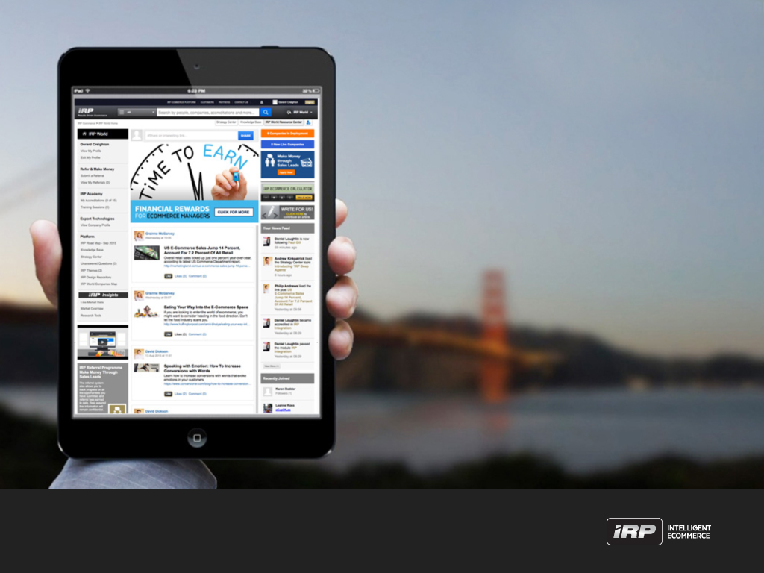
INTRODUCTION TO THE
IRP WORLD THEORY & WHY THIS APPROACH WORKS

Slide 10
WHAT IS THE IRP WORLD APPROACH
In our experience – good companies always get on top of their Logistics, Product and Customer Service
Even Great Companies STRUGGLE with Ecommerce
The IRP WORLD is a resource centre & ecosystem to help sales
The IRP World benchmarks performance and helps key decisions
We use the IRP World provide a Framework for Ecommerce to be Quantitative and all about sales
IRP World works by comparing like for like results in ecommerce to simply determine: WHAT IS GOOD
ECOMMERCE SUCCESS FOR IRP CUSTOMERS

Slide 11
WHAT IS THE IRP WORLD APPROACH
CONSTRUCTING A HOUSE
CONSTRUCTING ECOMMERCE SUCCESS
WHAT IS THE IRP WORLD

Slide 12
EXPLAINING THE IRP WORLD APPROACH
The IRP World creates a QUANTITATIVE approach to ecommerce
We mean that you do not just select your TEAM by how good THEY SAY they are performing
In the IRP WORLD we measure the performance of each element e.g., Google PPC, Paid Facebook, Email Marketing - in exactly the same way
We call these “Tradespeople” e.g., Google Adword providers “Service Providers” in the IRP WORLD that perform the “Service”
This is Objective and not Subjective
We COMPARE how well your Service Provider PERFORMS. This allows us to benchmark how well each element is PERFORMING in our joint interest
A PROVEN OBJECTIVE APPROACH TO ECOMMERCE

Slide 13
EXPLAINING THE IRP WORLD APPROACH
IRP WORLD anonymises measures and compares data from each Traffic Source and Service Provider
The IRP WORLD use statistical analysis to COMPARE Performance
By comparison with other Service Providers – IRP World knows if a TEAM are performing well or if there is room for improvement…. Not Subjectively, but Quantitatively
IRP World provides you this information to empower you the owners
Benchmarking makes this quantitative so you can be 100% sure of what and who and what is PERFORMING
WE BELIEVE THIS APPROACH IS SELF EVIDENT, FULL PROOF & HELPS SOLVE THE ECOMMERCE PROBLEM
IRP WORLD - BIG DATA AND STATISTICS – FULL PROOF

Slide 14

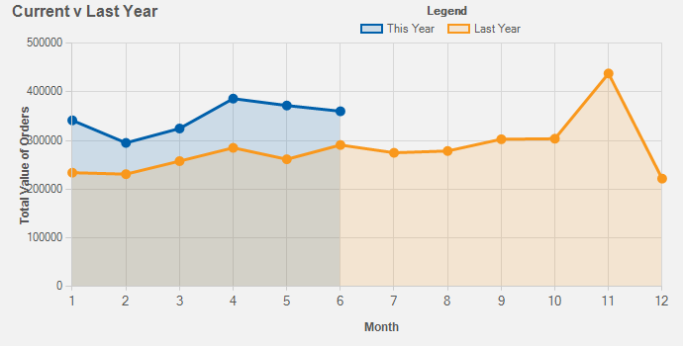
EXPLAINING IRP WORLD DATA - EXAMPLE
COMPANY A – EXAMPLE OF IRP WORLD DATA
Sales 2016: | £3,866,753
2017 Projected Sales: | £5,162,161 34% Growth
2017 Sales Target: | £6,000,000 -13.96%
2017 CPA Target: | 5%
Current CPA: | 5.79%
AOV £90 CLV £290 Conv 2.5% Bounce 58%
Dom 74% Int 26% Desk 65.60% Mob 34.40%
ORDERS FULLFILLED 98.5%. IRP EFFICIENCY 48.34%
AN EXAMPLE FROM THE IRP WORLD

Slide 15
EXPLAINING IRP WORLD DATA - EXAMPLE
COMPANY A – MAY 2017 SALES £370,000
IRP Digital Village Breakdown – works with 2 Providers in 5 Traffic Sources
Company Name | Traffic Source | Sales | Source CPA% | % of SALES
PPC AGENCY A | Google PPC | 190,883 | 9.19% | 51.20%
IN HOUSE | Facebook Paid | 56,260 | 1.17% | 19.87%
IN HOUSE | Affiliate Window | 26,424 | 8.15% | 7.42%
IN HOUSE | IRP Email Marketing | 25,954 | 0.00% | 7.92%
PPC AGENCY A | Bing % Yahoo PPC | 20,194 | 5.96% | 8.40%
IRP WORLD RANKS PPC AGENCY A 3rd of 5 for GOOGLE PPC, 2nd of 5 for BING PPC
ALL VERY INTERESTING – BUT IS THIS GOOD OR BAD?
AN EXAMPLE FROM THE IRP WORLD

Slide 16
EXPLAINING IRP WORLD DATA - EXAMPLE
COMPANY A - COMPARE THE PERFORMANCE TO THE BEST
Sales from Additional Traffic
Source | Current | Possible | Efficiency | Difference
GOOGLE PPC | £190,883 | £572,649 | 33.33% | £381,766
BING AND YAHOO PPC | £20,194 | £59,239 | 34.09% | £39,045
IRP EMAIL MARKETING | £25,954 | £55,548 | 46.72% | £29,594
AFFILIATE WINDOW | £26,424 | £132,120 | 20% | £105,696
FACEBOOK PAID | £56,260 | £456,152 | 12.33% | £399,892
 | POTENTIAL SALES FROM TRAFFIC |  |  | £955,993
Sales from Additional Conversion Rates
 | Current | Possible | Efficiency | Difference
Conversion Rate | 2.66% | 2.93% | 90.78% | 10.15%
 | POTENTIAL SALES FROM CONVERSION |  |  | £37,794
ARE THE RESULTS GOOD OR BAD

Slide 17
EXPLAINING IRP WORLD DATA - EXAMPLE
COMPANY A – COMPARISON IS KEY
Sales 2016: | £3,866,753
2017 Projected Sales: | £5,162,161 34% Growth
2017 Sales Target: | £6,000,000 -13.96%
IRP EFFICIENCY 48.34%
BY COMPARISON YOU SHINE A LIGHT ON YOUR ORGANISATION
Using Big Data and by comparison we reveal performance
IRP WORLD cannot always tell you what is wrong but it can tell you where to look
Knowing what and who is working well is key to success
WHAT DOES GOOD LOOK LIKE IN ECOMMERCE

Slide 18
WHY WE BELIEVE OUR APPROACH IS FULL PROOF
- record the actions taken and sales numbers
- record who is running the channel
- measure what happens to sales and costs of sales
- benchmark and give the results
- recommend the strategies that increase sales based off what works
- REPEAT PROCESS
IRP World will give you the Insights to help you manage your business & TRANSFORM YOUR ECOMMERCE
WE BELIEVE OUR APPROACH IS FULL PROOF

Slide 19
SUMMING UP HOW THE ECOMMERCE CHALLENGE IS SOLVED
You already have the product and market expertise
IRP has Ecommerce technology, and experience - spanning many markets
Our goal is to bring these 2 together collaboratively for your benefit
The IRP & IRP WORLD continually improves – as a solution it is moving in the right direction at an ever increasing speed
If collaboration, alignment and the IRP World are brought together - you have the foundation solve your Ecommerce challenge
ECOMMERCE SUCCESS FOR IRP CUSTOMERS

Slide 20
TAKEAWAYS: Help with Efficient Business Execution
We recognise that much of your eCommerce implementation work is undertaken by your teams.
To help with this we encourage you to
  ensure your teams are fully IRP trained
  instill a sales growth culture e.g. eCommerce team goals aligned with revenue and margin objectives (and bonus plans structured accordingly)
  encourage your teams to proactively collaborate closely with our teams, on planning, implementation and performance analysis
  Combine your sector knowledge with our eCommerce experience and trust our guidance and the IRP World data
ECOMMERCE SUCCESS FOR IRP CUSTOMERS

Slide 21
TAKEAWAYS: Help with Efficient Business Management
We recognise that your time is valuable yet you need to efficiently manage your business
To help with this we offer
  Access to IRP World and the IRP App (soon to be released)
  A short monthly executive summary & brief explanations of the implications.
  Our Executives for regular short business performance discussions (e.g. calls/meetings) at a suitable frequency
  To work closely with you when required (e.g. issue escalations) an open door policy for business escalation on a needs be basis and ask you to reciprocate
We are your key Ecommerce partner and we want you to be successful – it is a mutual success
ECOMMERCE SUCCESS FOR IRP CUSTOMERS

