Slide 1

Understanding Ecommerce Reporting for Accountants
& Maximising Ecommerce Sales for Business

Slide 2

Overview of Today’s Presentation
Introduction to some basic eCommerce theory
Introduction to the key elements of eCommerce Success
Introduction to a Cost of Sale model for online marketing
Conclusion
Q&A.

Slide 3
  The IRP ecommerce platform has transacted > 1,000,000,000 GBP for companies in NI
  This has led to a numbers based approach to Ecommerce
  Ecommerce is not just about having the right technology.
  It’s about maximising sales and profits.
  The right eCommerce Technology and the correct accounting framework work to systemise eCommerce success
  IRP – TECHNOLOGY | PEOPLE | INTELLIGENCE

Slide 4
  About the Ecommerce Market & How Companies should respond
  The eCommerce channel is growing
  It is important that companies act as barriers to entry are growing
  To succeed a company must be - ambitious, operationally capable, and in a good market….
  If the above traits are there – they have to follow a formula to succeed
  Accountants are well placed to understand ecommerce as it is a very numbers driven environment
  IRP – TECHNOLOGY | PEOPLE | INTELLIGENCE

Slide 5
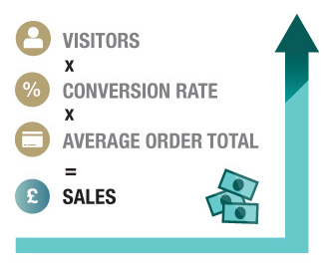
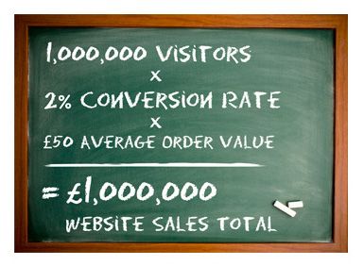
Introduction to Some Basic Ecommerce Theory
Like Retail or any other selling format – Ecommerce is just basic MATHS. The big difference is that the online selling channel is more complex and intangible

Slide 6
Key Elements of Ecommerce Success – Technology, People, Intelligence

Slide 7

People /
IRP World
Your 'digital village'
SERVICE PROVIDERS
Pay Per Click Marketeers
Facebook Marketeers
Affiliate Marketeers etc
Think Strava for Ecommerce….

Slide 8
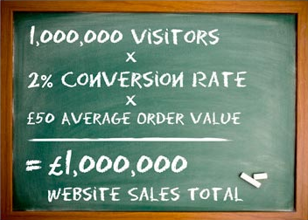
Sales – A Practical Look at the Mathematical Formula
  All that you need to do is cover the elements of the formula
  We directly increase each of the elements in the equation:
  Visitors – via precise digital marketing
  (PPC, Facebook, Email, Affiliates, etc.).
  Conversion Rate – via expert implementation
  of conversion principles – Identify Needs / Remove Blocks
  Average Order Value – via international sales
  expertise and the right customer retention and
  engagement strategies.

Slide 9
Online Traffic Costs Money – this should be measured as a CPA%
  All Ecommerce marketing should be calculated as a cost of sale
  For EBAY and Amazon – they will charge between 10 – 20% on sales
  Online marketing should be viewed in exactly the same way
  You need the right people to do the online marketing
  Then you measure their performance
  Cost / Sales *100= CPA%
  The CPA% is the CORE METRIC of ecommerce

Slide 10
Online Marketing is a Cost of Sale and not an Overhead
DATE | ONLINE SALES | ONLINE MARKETING SPEND | COST PER ACQUISITION % | OPERATING PROFIT MARGIN | PROFIT CALCULATION SALES- COST | ACTUAL PROFIT
July 2015 Online Sales | £100,000 | £5,000 | 5% | 15% | 15,000-5,000 | £10,000
July 2016 Online Sales | £200,000 | £10,000 | 5% | 15% | 30,000-10,000 | £20,000
Like Retail or any other selling format – Ecommerce is just basic MATHS. The big difference is that the selling channel is intangible

Slide 11
Some Key Takeaways
Accountants as in all parts of business – are key to Ecommerce success
The right reporting is required – CPA% based
Judgements should be numbers based
Pick Service providers based off their proven track record
Online marketing is a Cost of Sale and not an overhead
Services need to be measured consistently and compared
SUCCESS IS SYSTEMATIC AND NUMBERS BASED

Slide 12
Understanding Ecommerce Reporting for Accountants
& Maximising Ecommerce Sales for Business
Thanks for listening
We believe that accountants should play a lead role in ecommerce decision making because success is a formula and primarily numbers based
We have a number of further articles about accounting in ecommerce on
www.irpcommerce.com

